Slide 1
Initial Writing Robot
Walker Wind, Yanxi Piao, Dylan Wagman

Slide 2
(0,4)
(4,4)
Generating Paths
(0,4)
(4,4)
(0,0)
(4,0)
X: line1_xstart, line1_xend, line2_xstart, line2_xend, …
Y: line1_ystart, line1_yend, line2_ystart, line2_yend, ...
(0,0)
(4,0)
2
3
1
Lines: (1,4) -> (1,0), (1,2) ->(2,0)
X: 1,1,1,2
Y: 4,0,2,0
Curve: half circle with radius 1 centered at (1,3)
Theta: 1,1,3,6,2
¼ pi
4
0
5
7
6
Theta: radius, center_x, center_y, starting_angle, ending_angle

Slide 3
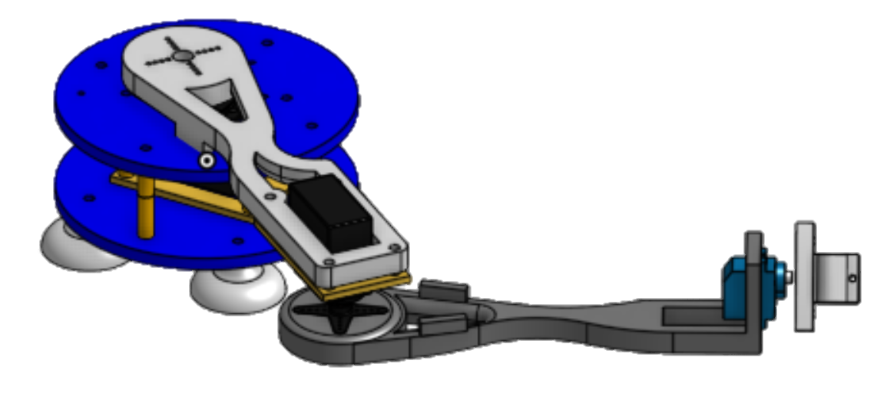
The Manipulator
IK Equations - Pseudo
def xy_to_ang(X,Y):
L_1 = 145 # Link Lengths
L_2 = 205 effector width
#solve for angles (q1 and q2), analytical
q[1] = atan2(sqrt(1-(((X**2)+(Y**2)-(L_1**2)-(L_2**2)) / (2*L_1*L_2))**2), ((X**2)+(Y**2)-(L_1**2) - (L_2**2)) / (2*L_1*L_2)) #q2
q[0] = atan2(Y,X) -atan2(L_2*sin(q[1]), L_1+L_2*cos(q[1]))#q1
#accounting for the direction of servo1
q = [int(degrees(q[0])),int(180 - degrees(q[1]))]
return q
2D Planar Arm
3 Servos
Features magnetic feet, that allow it to write on any magnetic surface (the whiteboard)
Code: https://github.com/walkerwind98/ME134

Slide 4

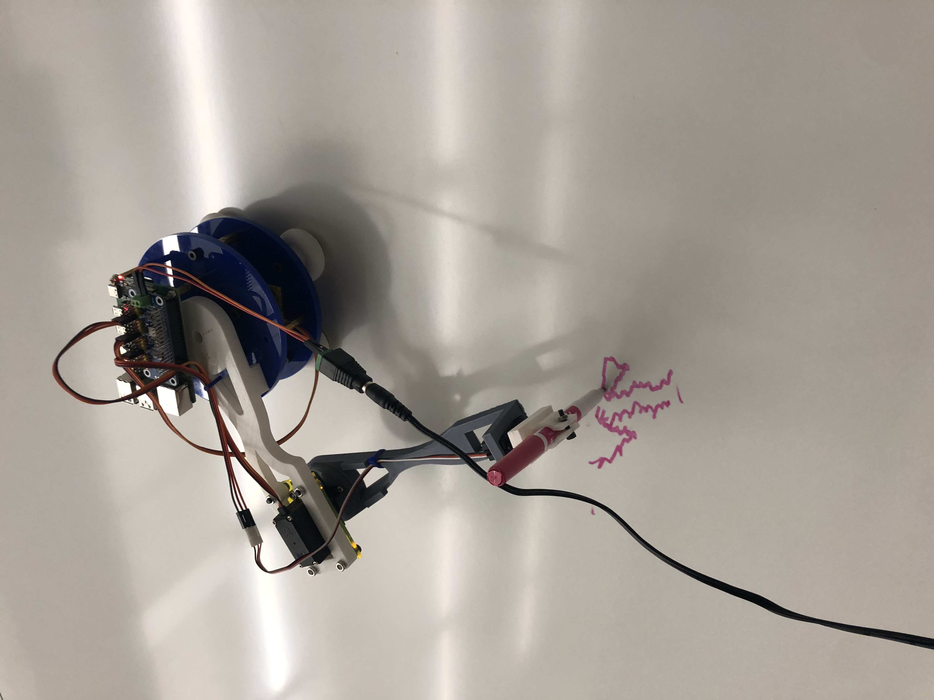
Walker Wind
DEMOS
Dylan Wagman
Yanxi Piao

Slide 5




Questions? Comments? Lifelong fears?

